Slide 1
Virtual Roll Call Team Members: Frank Vincench, Peter Reidy Product Owner: Jason Cohen Instructor: Masoud Sadjadi School of Computing and Information Sciences Florida International University
Senior Project Final Presentation Fall,2015
December 11,2015
Notes:
Greet your audience, thank them for attending your presentation, introduce yourself, introduce your project, introduce your team members, and quickly indicate what each of you did in a high-level manner, and put more emphasis on your part/contribution.

Slide 2
Problem definition
Project
Due to many factors, officers are not always present for roll call briefings. Officers may be in court, assigned to an overlapping shift or may have to start their tour early do to call volume. Virtual Roll call will allow for officers to be briefed on all the necessary information when feasible.
My Part
Completed the Officer and Administrator modules.
Notes:
Introduce the problem that the whole project tackles and stay focused on the parts that you have been working. Indicate if there is an existing previous system, enumerate its problems/limitations, etc.

Slide 3
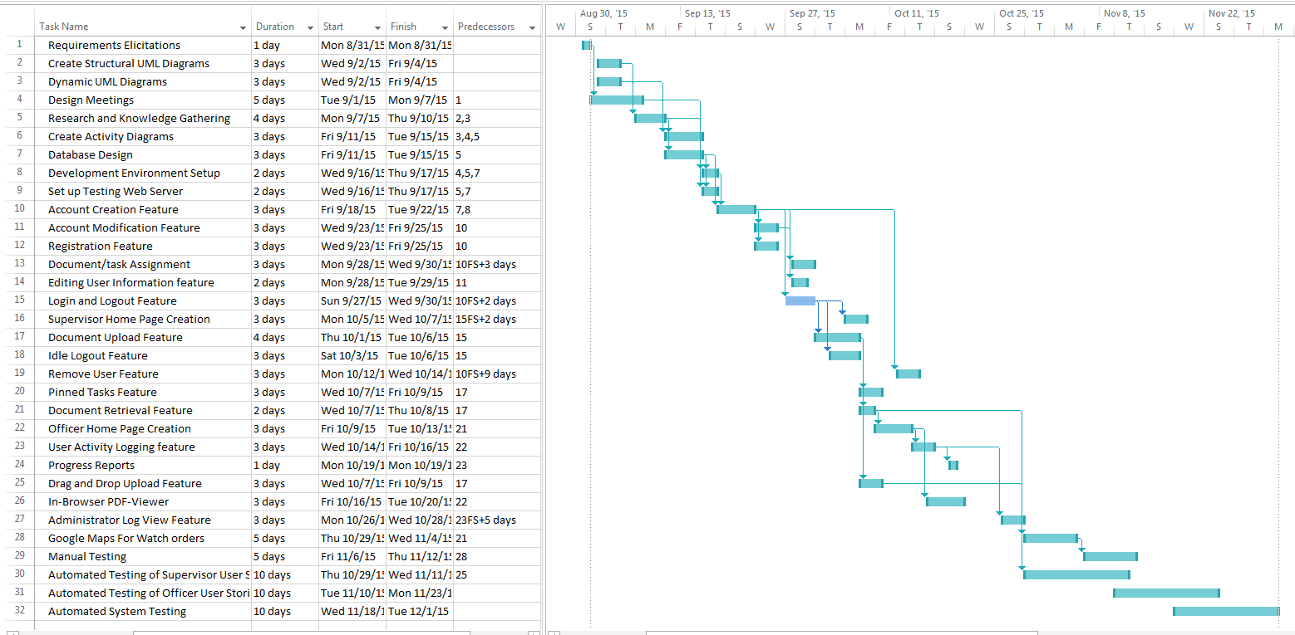
Project Management
Notes:
Project Management (schedule for entire semester) (one slide; Gantt Chart).

Slide 4
Requirements: User Stories
Module 1- Officer
Document Viewer, Dynamic document retrieval, Idle user logout, User authentication, Watch Orders – Google maps.
Module 3- Administrator
Register Users, View/Edit User information, Add New Categories, Monitor Users’ Activity, Idle User Logout, View As any type of user.
Most significant user story.
Document viewer.
Notes:
4. Requirements:
4.1. User stories implemented (one or more slides).
4.2. UML use cases and the use case diagram for the implemented use cases (one or more slides).
4.3. UML sequence diagrams for the implemented use cases.

Slide 5
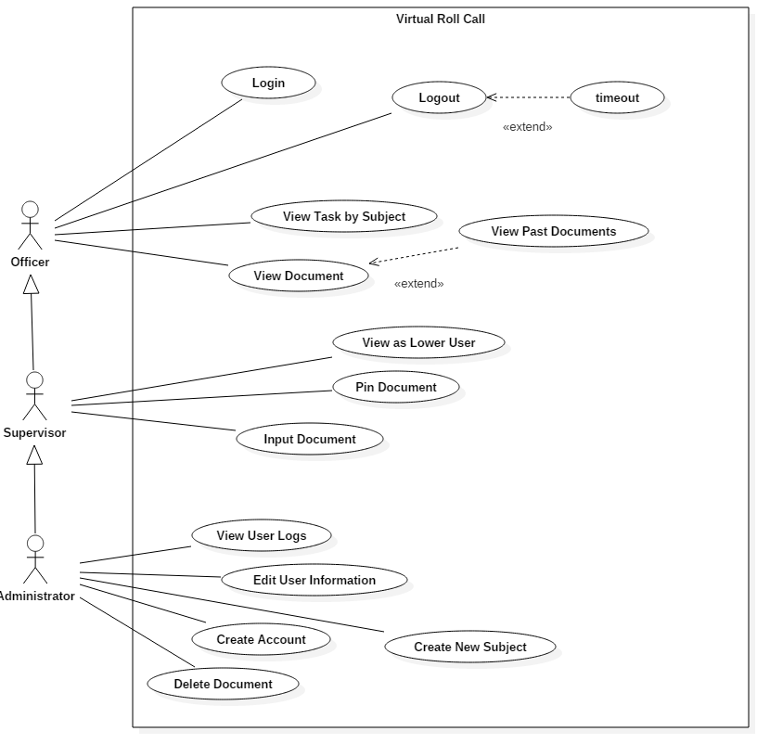
Requirements: Use Cases
View Documents
Officer Shift, Document lifetime, User Logs.
PDF.JS, IE limitations.
Notes:
4. Requirements:
4.1. User stories implemented (one or more slides).
4.2. UML use cases and the use case diagram for the implemented use cases (one or more slides).
4.3. UML sequence diagrams for the implemented use cases.

Slide 6
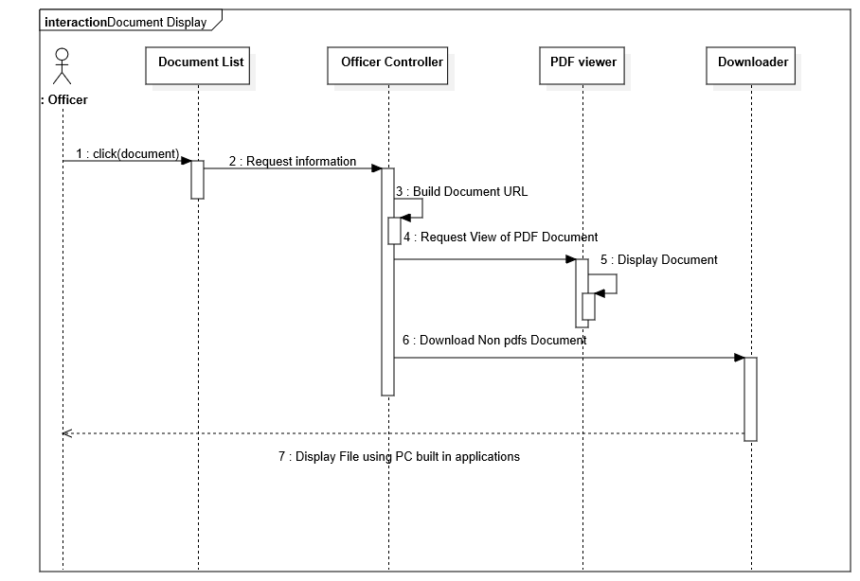
Requirements: Sequence Diagrams
Notes:
4. Requirements:
4.1. User stories implemented (one or more slides).
4.2. UML use cases and the use case diagram for the implemented use cases (one or more slides).
4.3. UML sequence diagrams for the implemented use cases.

Slide 7
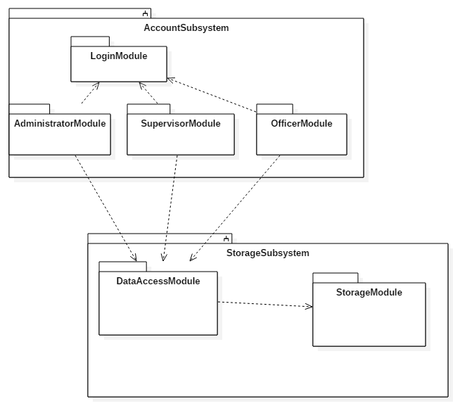
System Design: Architecture
MVC Architecture pattern
Notes:
5. System design:
5.1. System decomposition; identify the architecture patterns used (one slide).
5.2. System deployment – h/w and s/w requirements (one slide).
5.3. Persistent data design (one slide).
5.4. Security/Privacy (one slide).

Slide 8
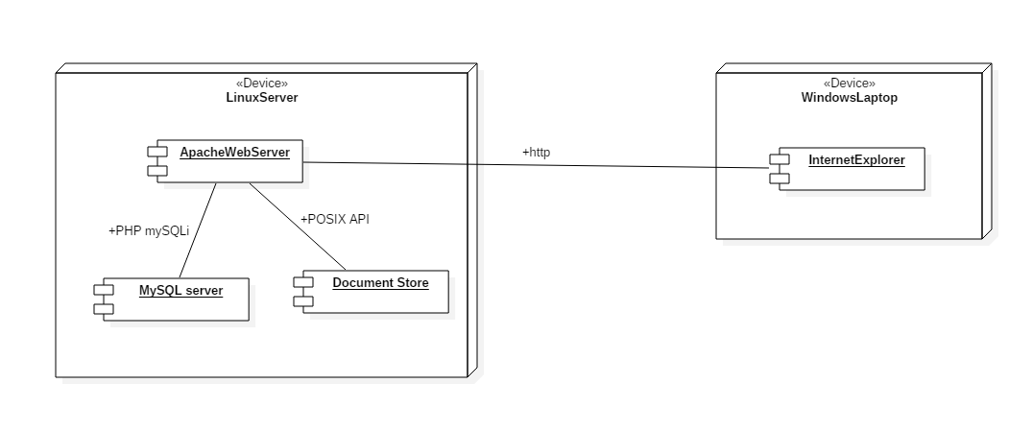
System Design: Deployment

Slide 9
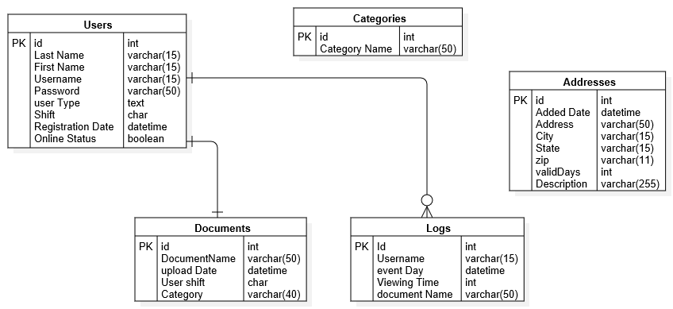
System Design
Persistent data design
Security/Privacy
Password Encryption- CryptoJS, Restricted network.
Notes:
5. System design:
5.1. System decomposition; identify the architecture patterns used (one slide).
5.2. System deployment – h/w and s/w requirements (one slide).
5.3. Persistent data design (one slide).
5.4. Security/Privacy (one slide).

Slide 10
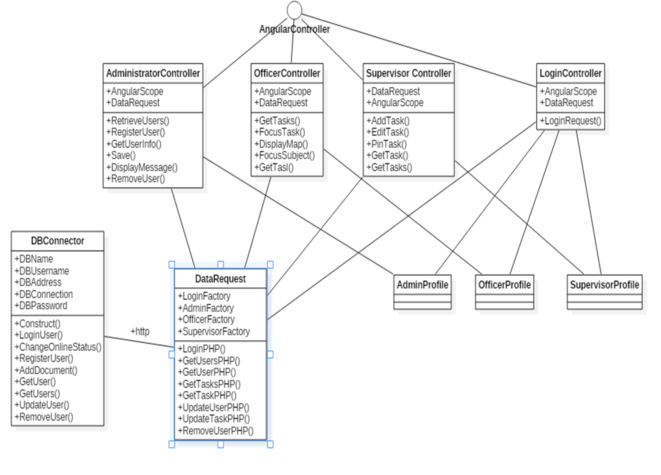
Class Diagram
Singleton pattern
Notes:
6. Detailed design:
6.1. Minimal class diagram. Identify the design patterns used (one or more slides).
6.2. State machine for the main control object or the most important object of the implemented uses cases (one or more slides).
6.3. Main algorithm used related to an implemented use case described above (one or more slides).

Slide 11
Main algorithm
The system is designed Using Angular JS to handle the client side and PHP to handle the server side.
Information/communication is exchanged between the client/server side through a series of dynamic http post requests that occur depending on the user’s need of the system.
Notes:
6. Detailed design:
6.1. Minimal class diagram. Identify the design patterns used (one or more slides).
6.2. State machine for the main control object or the most important object of the implemented uses cases (one or more slides).
6.3. Main algorithm used related to an implemented use case described above (one or more slides).

Slide 12
Test Suites and Test Cases
Sunny Day
Rainy Day
Create an account Properly
Logged in as an administrator
Last Name: Doe First Name: Jane username: Jane password: jane type of officer: Supervisor officer Shift: B
Expected success due to new username should delete the User In tear down of test
Create an account with another users credentials
Logged in as an administrator
Last Name: Frank First Name: Vincench username: Frank password: frank type of officer: Supervisor officer Shift: B
Expected Failure due to the username frank already taken
Notes:
7. Test Suites and Test Cases (one sunny day and one rainy day) for the use case represented in part (5) above (2 slides).
7.1 One sunny day and one rainy day for the implemented use cases (one or more slides).
7.2 Automated test scripts for the implemented use cases (one or more slides).

Slide 13
Summary
Virtual Roll Call is network based where supervisory staff can input relevant information into the software and officers can log in and review the latest postings.
Frank Vincench (developer)
Email: Fvinc004@fiu.edu
305-200-7348
Questions?
Thank You!
Notes:
Summarize your contribution
Include your contact information
Ask if anyone has any questions for you.
Thank your audience

